Slide 1
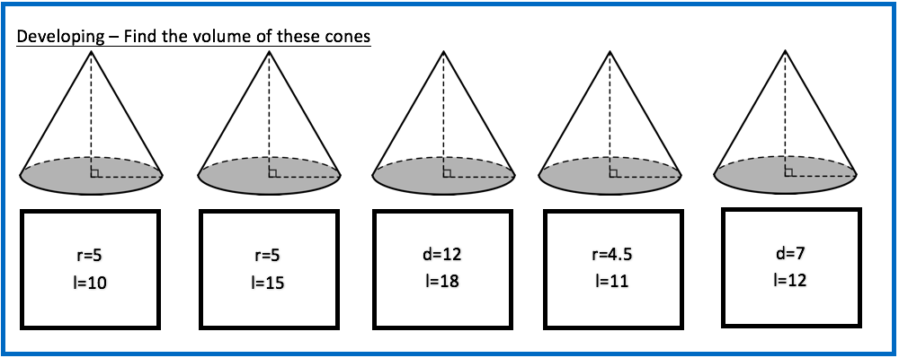
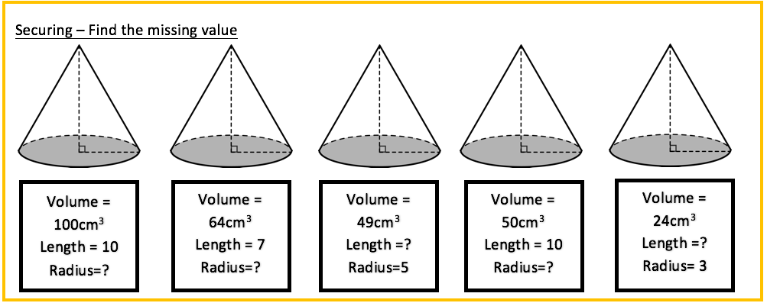
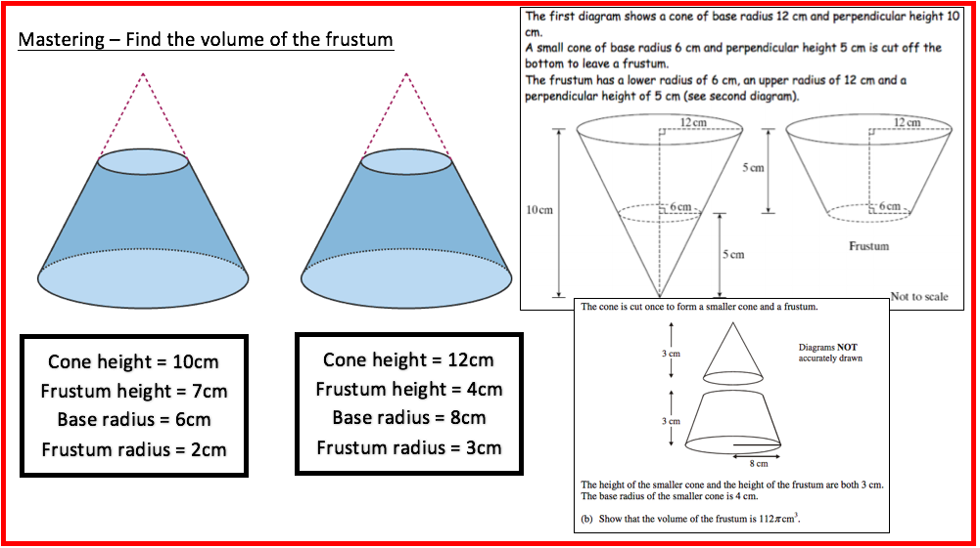

Slide 2
Developing
261.799
314.159
678.584
233.263
153.939
Securing
3.090
2.955
1.872
2.185
2.546
Mastering
347.670
766.549
1319.469

