Slide 1
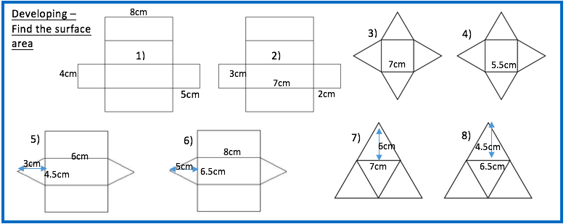
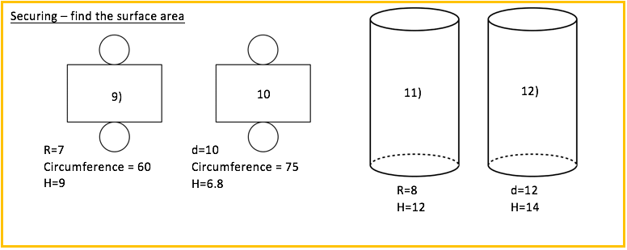
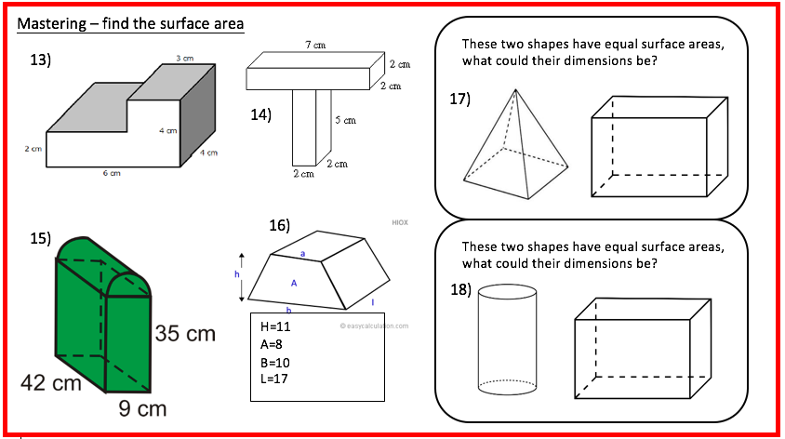

Slide 2
Developing
(8x4x2)+(8x5x2)+(5x4x2)=64+80+40=184cm²
(7x3x2)+(3x2x2)+(7x2x2)=42+12+28=82cm²
(7x7)+(7x7x4)/2=49+123=172cm²
(5.5x5.5)+(5.5x5.5x4)/2=91.19cm²
(3x4.5)+(6x3x2)+(4.5x6)=76.5cm²
(5x6.5)+(8x5x2)+(6.5x8)=164.5cm²
(6x7x4)/2=84cm²
(4.5x6.5x4)/2=58.5cm²
Securing
9) 847.976cm²
10) 667.080cm²
11) 779.115cm²
12) 753.982cm²
Mastering
13) 16+12+8+16+8+24+12+12+6+6=108cm²
14) 42+8+10+10+10+10+10+4=100cm²
15) 4605.378cm²
16) 844cm²
17) Multiple answers
18) Multiple answers

