Slide 1
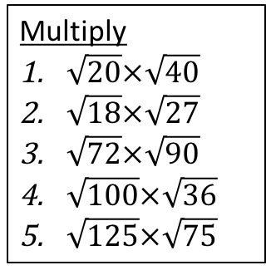
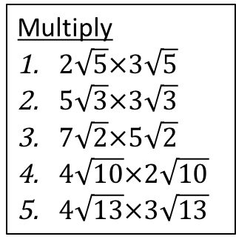
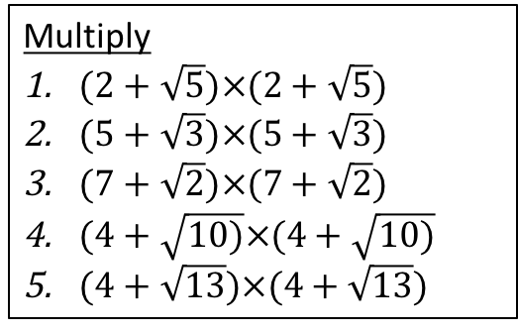
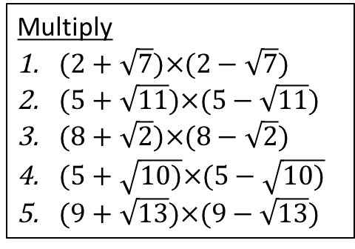



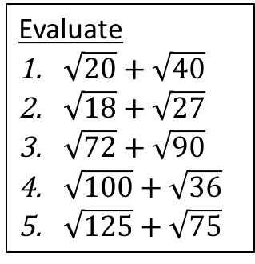
Developing
Evaluate
$\sqrt{20}+\sqrt{40}$
$\sqrt{18}+\sqrt{27}$
$\sqrt{72}+\sqrt{90}$
$\sqrt{100}+\sqrt{36}$
$\sqrt{125}+\sqrt{75}$
Multiply
$\sqrt{20}×\sqrt{40}$
$\sqrt{18}×\sqrt{27}$
$\sqrt{72}×\sqrt{90}$
$\sqrt{100}×\sqrt{36}$
$\sqrt{125}×\sqrt{75}$
Multiply
$2\sqrt{5}×3\sqrt{5}$
$5\sqrt{3}×3\sqrt{3}$
$7\sqrt{2}×5\sqrt{2}$
$4\sqrt{10}×2\sqrt{10}$
$4\sqrt{13}×3\sqrt{13}$
Securing
Multiply
$(2+\sqrt{5})×(2+\sqrt{5})$
$(5+\sqrt{3})×(5+\sqrt{3})$
$(7+\sqrt{2})×(7+\sqrt{2})$
$(4+\sqrt{10)}×(4+\sqrt{10)}$
$(4+\sqrt{13})×(4+\sqrt{13})$
Multiply
$(2+\sqrt{7})×(2−\sqrt{7})$
$(5+\sqrt{11})×(5−\sqrt{11})$
$(8+\sqrt{2})×(8−\sqrt{2})$
$(5+\sqrt{10)}×(5−\sqrt{10)}$
$(9+\sqrt{13})×(9−\sqrt{13})$
Mastering
Multiply
$\frac{3}{2+\sqrt{5}}×\frac{2−\sqrt{5}}{2−\sqrt{5}}$
$\frac{4}{3+\sqrt{7}}×\frac{3−\sqrt{7}}{3−\sqrt{7}}$
$\frac{7}{5+\sqrt{8}}×\frac{5−\sqrt{8}}{5−\sqrt{8}}$
$\frac{\sqrt{7}}{1+\sqrt{7}}×\frac{1−\sqrt{7}}{1−\sqrt{7}}$
$\frac{\sqrt{3}}{1+\sqrt{2}}×\frac{1−\sqrt{2}}{1−\sqrt{2}}$
Rationalise
$\frac{5}{3+\sqrt{11}}$
$\frac{\sqrt{2}}{5−\sqrt{7}}$
$\frac{7}{9−\sqrt{2}}$
$\frac{\sqrt{7+2}}{1+\sqrt{7}}$
$\frac{\sqrt{3}−2}{1+\sqrt{2}}$
Rationalise
$\frac{5+\sqrt{2}}{3+\sqrt{11}}$
$\frac{3+\sqrt{2}}{5−\sqrt{2}}$
$\frac{7+\sqrt{2}}{9−\sqrt{2}}$
$\frac{4−\sqrt{7}}{1+\sqrt{7}}$
$\frac{\sqrt{2}−2}{11−\sqrt{11}}$

Slide 2


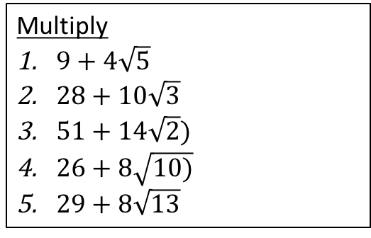
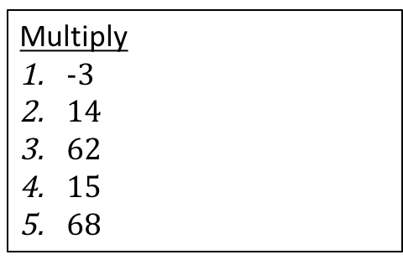




Developing
Evaluate
$2\sqrt{10}+2\sqrt{5}$
$3\sqrt{3}+3\sqrt{2}$
$3\sqrt{10}+6\sqrt{2}$
16
$5\sqrt{5}+5\sqrt{3}$
Multiply
$20\sqrt{2}$
$9\sqrt{6}$
36$\sqrt{5}$
$60$
$25\sqrt{15}$
Multiply
$30$
$45$
$70$
$80$
$156$
Securing
Multiply
$9+4\sqrt{5}$
$28+10\sqrt{3}$
$51+14\sqrt{2})$
$26+8\sqrt{10)}$
$29+8\sqrt{13}$
Multiply
$-3$
$14$
$62$
$15$
$68$
Mastering
Multiply
$\frac{3\sqrt{5}}{10}$
$6−2\sqrt{7}$
$\frac{35−14\sqrt{2}}{17}$
$\frac{7−\sqrt{7}}{6}$
$\sqrt{6}−\sqrt{3}$
Rationalise
$\frac{−50+15\sqrt{11}}{2}$
$\frac{14+5\sqrt{2}}{18}$
$\frac{63+7\sqrt{2}}{79}$
$\frac{−1+\sqrt{7}}{2}$
$\frac{\sqrt{3}−\sqrt{6}−2−2\sqrt{2}}{−1}$
Rationalise
$\frac{15−5\sqrt{11}+3\sqrt{2}−\sqrt{22}}{−2}$
$\frac{17+3\sqrt{2}}{23}$
$\frac{65+16\sqrt{2}}{79}$
$\frac{−11+5\sqrt{7}}{6}$
$\frac{11\sqrt{2}+\sqrt{22}−22−2\sqrt{11}}{110}$

