Slide 1
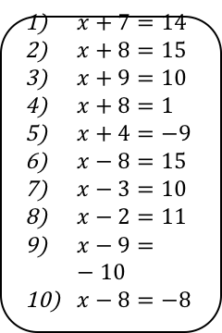
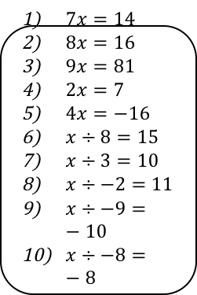




Developing – Solve one and two step equations
Solve for x
Solve for x
Solve for x
$x+7=14$
$x+8=15$
$x+9=10$
$x+8=1$
$x+4=−9$
$x−8=15$
$x−3=10$
$x−2=11$
$x−9=−10$
$x−8=−8$
$7x=14$
$8x=16$
$9x=81$
$2x=7$
$4x=−16$
$x÷8=15$
$x÷3=10$
$x÷−2=11$
$x÷−9=−10$
$x÷−8=−8$
$2x+4=14$
$8x+8=16$
$9x+9=81$
$5x−5=25$
$4x−4=−16$
$\frac{x}{3}−9=4$
$\frac{x}{4}−8=16$
$\frac{x}{5}+9=25$
Securing – Solve the following equations
Solve for x
Solve for x
Solve for x
2($x+7) =14$
$3(x+8)=15$
$4(x+9)=10$
$5(x+8)=1$
$7(x+4)=−7$
$−2(x−8)=15$
$4(x−3)=10$
$−2(x−2)=11$
$−2(x−9)=−10$
$−(x−8)=−8$
$\frac{x+8}{2} =14$
$\frac{x−2}{3} =1$
$\frac{x−4}{8} =−1$
$\frac{x−5}{5} =−2$
$\frac{2x−2}{2} =2$
$\frac{3x−2}{−4} =−4$
$x^{2}=49$ there are two answers!
$x^{2}=81$
$x^{2}−6=30$
$x^{2}+9=109$
${2x}^{2}=50$
${3x}^{2}=27$
$5x^{2}+10=110$
${3x}^{2}=60$
Mastering
3x-60º
3x-60º
x-2
80º
3
3x-60º
3x-60º
3x-60º
Solve for x
Solve for x
2x
Solve for x, area = 60cm²

Slide 2


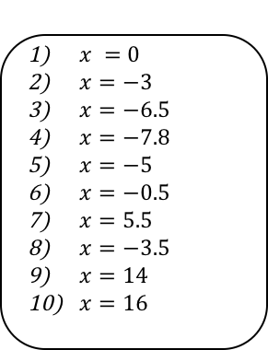



Developing
$x=7$
$x=7$
$x=1$
$x=−9$
$x=−13$
$x=23$
$x=13$
$x=13$
$x=−1$
$x=0$
$x=2$
$x=2$
$x=9$
$x=3.5$
$x=−4$
$x=120$
$x=30$
$x=−22$
$x=90$
$x=64$
$x=5$
$x=1$
$x=8$
$x=6$
$x=−3$
$x=39$
$x=96$
$x=80$
Securing
$x =0$
$x=−3$
$x=−6.5$
$x=−7.8$
$x=−5$
$x=−0.5$
$x=5.5$
$x=−3.5$
$x=14$
$x=16$
$x =20$
$x =5$
$x =−4$
$x =−5$
$x =3$
$x=6$
$x=7,−7$
$x=9,−9$
$x=6,−6$
$x=10,−10$
$x=5,−5$
$x=3,−3$
$x=5,−5$
$x=4.472,−4.472$
Mastering
5x-30=180
5x=210
x=42
3x-60=90
3x=150
x=50
(x-2+2x)x3x0.5
(9x-6)x0.5=60
9x-6=120
9x=126
x=14

