Slide 1
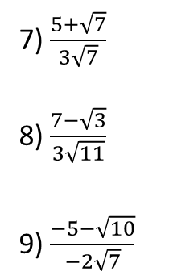
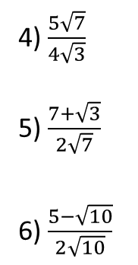





Developing – Rationalise the denominator
1) $\frac{3}{\sqrt{5}}$
2) $\frac{2}{\sqrt{7}}$
3) $\frac{4}{2\sqrt{3}}$
Developing – Rationalise the denominator
1) $\frac{\sqrt{2}}{\sqrt{5}}$
2) $\frac{2\sqrt{3}}{\sqrt{7}}$
3) $\frac{4\sqrt{2}}{2\sqrt{3}}$
4) $\frac{5}{4\sqrt{3}}$
5) $\frac{7}{2\sqrt{7}}$
6) $\frac{5}{2\sqrt{10}}$
7) $\frac{3}{5\sqrt{2}}$
8) $\frac{11}{3\sqrt{3}}$
9) $\frac{5}{5\sqrt{5}}$
4) $\frac{5\sqrt{7}}{4\sqrt{3}}$
5) $\frac{7+\sqrt{3}}{2\sqrt{7}}$
6) $\frac{5−\sqrt{10}}{2\sqrt{10}}$
7) $\frac{5+\sqrt{7}}{3\sqrt{7}}$
8) $\frac{7−\sqrt{3}}{3\sqrt{11}}$
9) $\frac{−5−\sqrt{10}}{−2\sqrt{7}}$
Securing - Rationalise the denominator
1) $\frac{3}{3+\sqrt{7}}$
2) $\frac{2}{4+\sqrt{5}}$
3) $\frac{6}{2−\sqrt{7}}$
4) $\frac{5}{7−\sqrt{3}}$
5) $\frac{\sqrt{7}}{2+\sqrt{3}}$
6) $\frac{\sqrt{5}}{4+\sqrt{7}}$
7) $\frac{\sqrt{10}}{3−\sqrt{2}}$
8) $\frac{\sqrt{3}}{\sqrt{7}−10}$
9) $\frac{5\sqrt{5}}{5+\sqrt{11}}$
10) $\frac{3\sqrt{3}}{\sqrt{7}+14}$
11) $\frac{2\sqrt{7}}{8−\sqrt{2}}$
12) $\frac{4\sqrt{5}}{9−\sqrt{3}}$
13) $\frac{6+\sqrt{7}}{5+\sqrt{3}}$
14) $\frac{2+\sqrt{3}}{3+\sqrt{5}}$
15) $\frac{5+\sqrt{5}}{5−\sqrt{3}}$
16) $\frac{3−\sqrt{7}}{5−\sqrt{2}}$
Mastering – Rationalise then answer
1) $\frac{3}{\sqrt{18}}+\frac{5}{\sqrt{72}}$
2) $\frac{2}{\sqrt{27}}+\frac{2}{\sqrt{48}}$
3) $\frac{4}{\sqrt{20}}−\frac{7}{\sqrt{45}}$
4) $\frac{6}{\sqrt{32}}−\frac{3}{\sqrt{72}}$
Mastering – Find $x$ in its simplest form
$$\sqrt{38}$$
$$\sqrt{20}$$
$$x$$

Slide 2
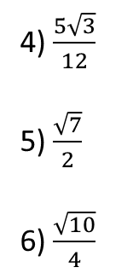




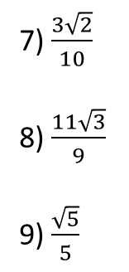

Developing – Rationalise the denominator
1) $\frac{3\sqrt{5}}{5}$
2) $\frac{2\sqrt{7}}{7}$
3) $\frac{2\sqrt{3}}{3}$
Developing – Rationalise the denominator
1) $\frac{\sqrt{10}}{5}$
2) $\frac{2\sqrt{21}}{7}$
3) $\frac{2\sqrt{6}}{3}$
4) $\frac{5\sqrt{3}}{12}$
5) $\frac{\sqrt{7}}{2}$
6) $\frac{\sqrt{10}}{4}$
7) $\frac{3\sqrt{2}}{10}$
8) $\frac{11\sqrt{3}}{9}$
9) $\frac{\sqrt{5}}{5}$
4) $\frac{5\sqrt{21}}{12}$
5) $\frac{7\sqrt{7}+\sqrt{21}}{14}$
6) $\frac{\sqrt{10}−2}{4}$
7) $\frac{7+5\sqrt{7}}{21}$
8) $\frac{−\sqrt{33}+7\sqrt{11}}{33}$
9) $\frac{5\sqrt{7}+\sqrt{70}}{14}$
Securing - Rationalise the denominator
1) $\frac{9−3\sqrt{7}}{2}$
2) $\frac{8−2\sqrt{5}}{11}$
3) $−4−2\sqrt{7}$
4) $\frac{35+5\sqrt{3}}{46}$
5) $−\sqrt{21}+2\sqrt{7}$
6) $\frac{−\sqrt{35}+4\sqrt{5}}{9}$
7) $\frac{3\sqrt{10}+2\sqrt{5}}{7}$
8) - $\frac{\sqrt{21}+10\sqrt{3}}{93}$
9) $\frac{−5\sqrt{55}+25\sqrt{5}}{14}$
10) $\frac{−\sqrt{21}+14\sqrt{3}}{63}$
11) $\frac{\sqrt{14}+8\sqrt{7}}{31}$
12) $\frac{2\sqrt{15}+18\sqrt{5}}{39}$
13) $\frac{30−6\sqrt{3}+5\sqrt{7}−\sqrt{21}}{22}$
14) $\frac{6−2\sqrt{5}+3\sqrt{3}−\sqrt{15}}{4}$
15) $\frac{25+5\sqrt{5}+5\sqrt{3}+\sqrt{15}}{22}$
16) $\frac{15−5\sqrt{7}+3\sqrt{2}−\sqrt{14}}{23}$
Mastering – Rationalise then answer
1) $\frac{11\sqrt{2}}{12}$
2) $\frac{7\sqrt{3}}{18}$
3) $−\frac{\sqrt{5}}{15}$
4) $\frac{\sqrt{2}}{2}$
Mastering – Find $x$ in its simplest form
$$\sqrt{38}$$
$$\sqrt{20}$$
$$x$$
$$x=\sqrt{18}=3\sqrt{2}$$

