Slide 1
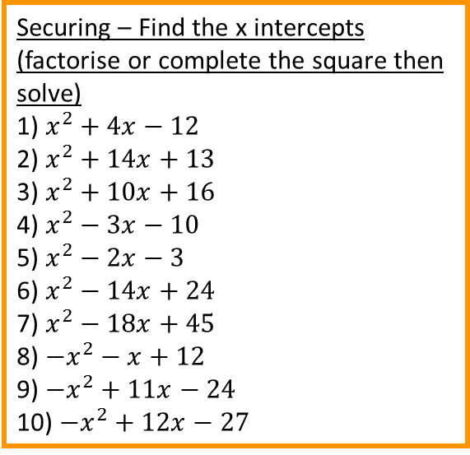
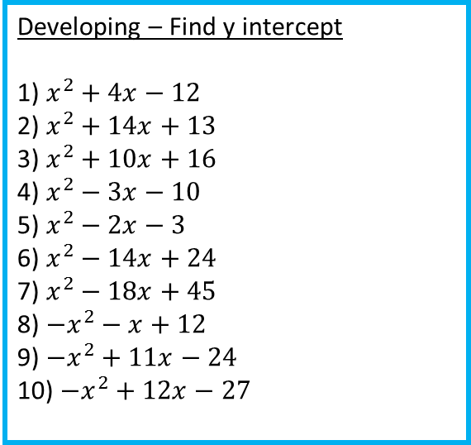
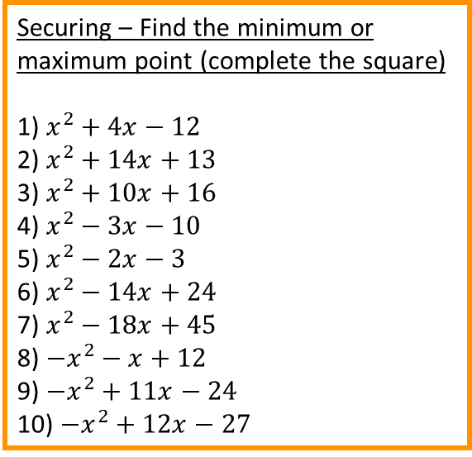
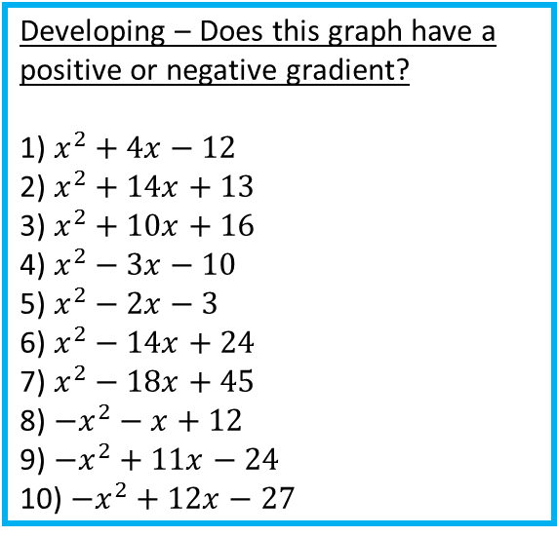
Developing – Does this graph have a positive or negative gradient?
1) $x^{2}+4x−12$
2) $x^{2}+14x+13$
3) $x^{2}+10x+16$
4) $x^{2}−3x−10$
5) $x^{2}−2x−3$
6) $x^{2}−14x+24$
7) $x^{2}−18x+45$
8) ${−x}^{2}−x+12$
9) ${−x}^{2}+11x−24$
10) ${−x}^{2}+12x−27$
Developing – Find y intercept
1) $x^{2}+4x−12$
2) $x^{2}+14x+13$
3) $x^{2}+10x+16$
4) $x^{2}−3x−10$
5) $x^{2}−2x−3$
6) $x^{2}−14x+24$
7) $x^{2}−18x+45$
8) ${−x}^{2}−x+12$
9) ${−x}^{2}+11x−24$
10) ${−x}^{2}+12x−27$
Securing – Find the x intercepts (factorise or complete the square then solve)
1) $x^{2}+4x−12$
2) $x^{2}+14x+13$
3) $x^{2}+10x+16$
4) $x^{2}−3x−10$
5) $x^{2}−2x−3$
6) $x^{2}−14x+24$
7) $x^{2}−18x+45$
8) ${−x}^{2}−x+12$
9) ${−x}^{2}+11x−24$
10) ${−x}^{2}+12x−27$
Securing – Find the minimum or maximum point (complete the square)
1) $x^{2}+4x−12$
2) $x^{2}+14x+13$
3) $x^{2}+10x+16$
4) $x^{2}−3x−10$
5) $x^{2}−2x−3$
6) $x^{2}−14x+24$
7) $x^{2}−18x+45$
8) ${−x}^{2}−x+12$
9) ${−x}^{2}+11x−24$
10) ${−x}^{2}+12x−27$
Mastering – Plot the graph using the minimum point, x and y intercepts
(You can complete the square and then solve for x to find the x intercepts)
1) $2x^{2}+8x+6$
2) $3x^{2}+6x−9$
3) $4x^{2}+10x+2$
4) $2x^{2}−7x+8$
Can you find the equation of the line from this graphs?

Slide 2
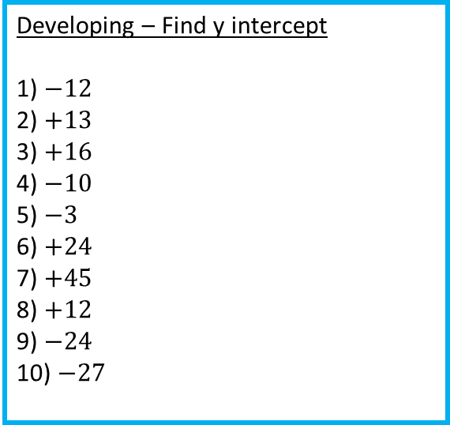
Developing – Does this graph have a positive or negative gradient?
Positive
Positive
Positive
Positive
Positive
Positive
Positive
Negative
Negative
Negative
Developing – Find y intercept
1) $−12$
2) $+13$
3) $+16$
4) $−10$
5) $−3$
6) $+24$
7) $+45$
8) $+12$
9) $−24$
10) $−27$
Securing – Find the x intercepts (factorise or complete the square then solve)
$x=−6, x=2$
$x=−13, x=−1$
3) $x=−8, x=−2$
4) $x=5, x=−2$
5) $x=3, x=−1$
6) $x=2, x=12$
7) $x=3, x=15$
8) $x=3, x=−4$
9) $x=8, x=3$
10) $x=9, x=3$
Securing – Find the minimum or maximum point (complete the square)
1) $(2,−16)$
2) $(−7,−36)$
3) $(−5,−19)$
4) $(1.5, −12.25)$
5) $(1,−4)$
6) $(7, 2$5)
7) $(9,−36)$
8) $(−0.5, −11.75)$
9) $(−5.5, 6.25)$
10) $(6, 9)$
Mastering – Plot the graph using the minimum point, x and y intercepts
(You can complete the square and then solve for x to find the x intercepts)
Can you find the equation of the line from this graphs?
$$y=x^{2}+4x−2$$

