Slide 1
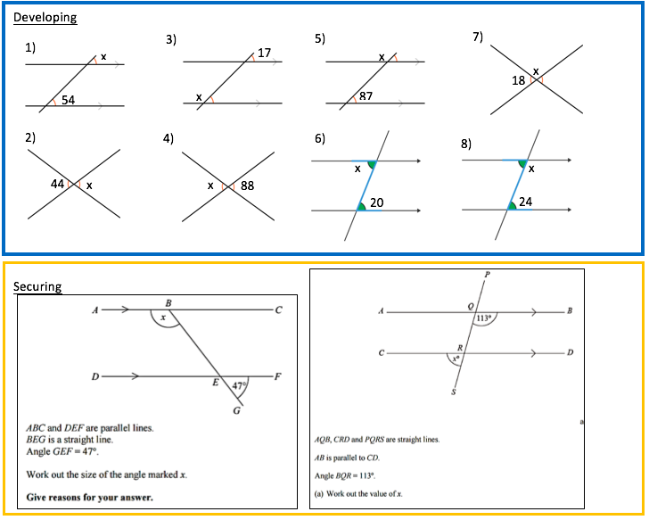
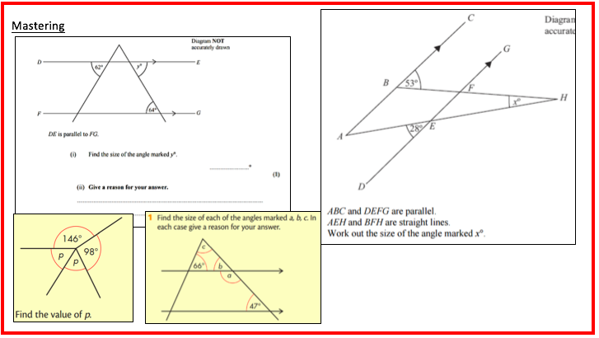

Slide 2
Developing
54
44
163
88
93
20
162
156
Securing
180-47=133, x=133, alternate angles
180-113=67
Mastering
Y=64, alternate angles
58
A=133, b=47, c=67
X=45

