Slide 1
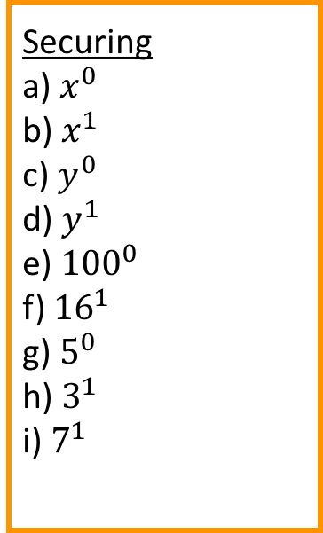
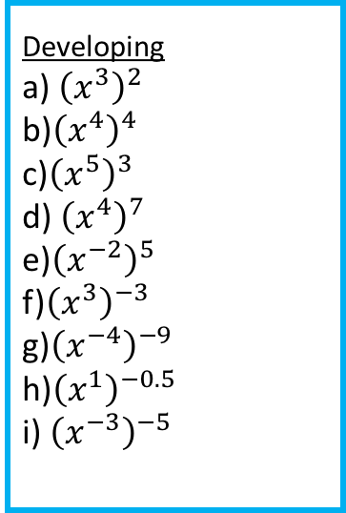
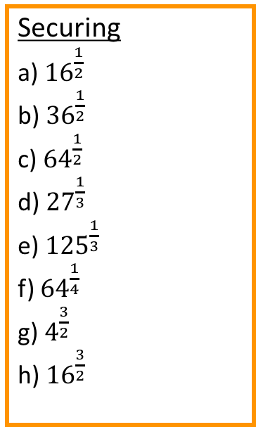


Developing
a) $x^{2}×x^{3}$
b) $x^{5}×x^{6}$
c) $x^{2}×x^{1}$
d) $x^{1}×x^{−2}$
e) $3^{2}×3^{−2}$
f) $4^{2}×4^{7}$
g) $5^{3}×5^{7}$
h) $5^{7}×5^{5}$
i) $6^{−1}×6^{−5}$
Developing
a) $x^{4}÷x^{2}$
b) $x^{6}÷x^{3}$
c) $x^{9}÷x^{2}$
d) $x^{10}÷x^{4}$
e) $7^{4}÷7^{4}$
f) $6^{3}÷6^{−3}$
g) $6^{2}÷6^{4}$
h) $6^{3}÷6^{6}$
i) $6^{−2}÷6^{−4}$
Developing
a) ${\left(x^{3}\right)}^{2}$
b)${\left(x^{4}\right)}^{4}$
c)${\left(x^{5}\right)}^{3}$
d) ${\left(x^{4}\right)}^{7}$
e)${\left(x^{−2}\right)}^{5}$
f)${\left(x^{3}\right)}^{−3}$
g)${\left(x^{−4}\right)}^{−9}$
h)${\left(x^{1}\right)}^{−0.5}$
i) ${\left(x^{−3}\right)}^{−5}$
Securing
a) $x^{0}$
b) $x^{1}$
c) $y^{0}$
d) $y^{1}$
e) ${100}^{0}$
f) ${16}^{1}$
g) $5^{0}$
h) $3^{1}$
i) $7^{1}$
Securing
a) ${16}^{\frac{1}{2}}$
b) ${36}^{\frac{1}{2}}$
c) ${64}^{\frac{1}{2}}$
d) ${27}^{\frac{1}{3}}$
e) ${125}^{\frac{1}{3}}$
f) ${64}^{\frac{1}{4}}$
g) $4^{\frac{3}{2}}$
h) ${16}^{\frac{3}{2}}$
Securing
a)$3^{−1}$
b) $2^{−1}$
c) $7^{−1}$
d) ${11}^{−1}$
e) $3^{−2}$
f) $7^{−2}$
g) $8^{−2}$
h) $3^{−3}$
i) $4^{−3}$
Mastering
${\left(x^{}\right)}^{2}=x^{8}$
$y^{10}×y^{4}={}^{14}$
$t^{5}÷t^{}={}^{3}$
${\left({}^{2}\right)}^{2}=x^{}$
$x^{}×{}^{2}=x^{8}$
$x^{7}÷x^{}=x^{1}$
${\left(y^{}\right)}^{}=y^{10}$
$3^{5}×3^{}=3^{10}$
$x^{12}÷x^{}=x^{10}$
${\left(4^{2}\right)}^{2}=4^{}$
$x^{12}×x^{}=x^{14}$
$1^{}÷1^{1}=1^{6}$

Slide 2
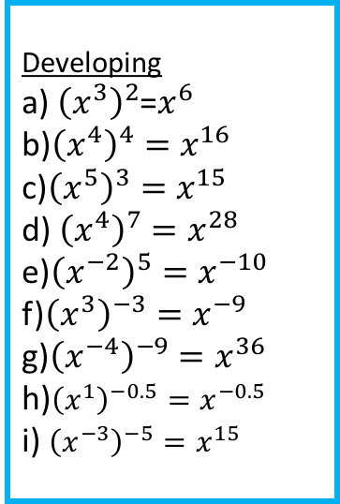
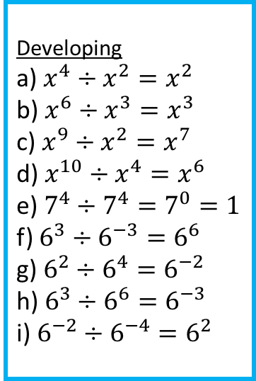
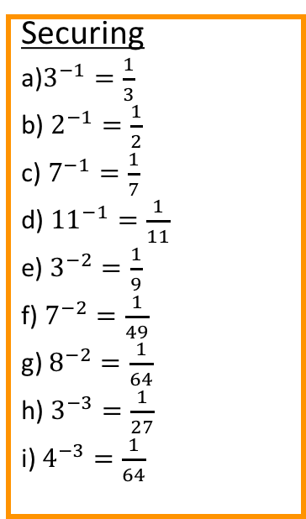


Developing
a) $x^{2}×x^{3}=x^{5}$
b) $x^{5}×x^{6}=x^{11}$
c) $x^{2}×x^{1}=x^{3}$
d) $x^{1}×x^{−2}=x^{−1}$
e) $3^{2}×3^{−2}=3^{0}=1$
f) $4^{2}×4^{7}=4^{9}$
g) $5^{3}×5^{7}=5^{10}$
h) $5^{7}×5^{5}=5^{12}$
i) $6^{−1}×6^{−5}$=$6^{−6}$
Developing
a) $x^{4}÷x^{2}=x^{2}$
b) $x^{6}÷x^{3}=x^{3}$
c) $x^{9}÷x^{2}=x^{7}$
d) $x^{10}÷x^{4}=x^{6}$
e) $7^{4}÷7^{4}=7^{0}=1$
f) $6^{3}÷6^{−3}=6^{6}$
g) $6^{2}÷6^{4}=6^{−2}$
h) $6^{3}÷6^{6}=6^{−3}$
i) $6^{−2}÷6^{−4}=6^{2}$
Developing
a) ${\left(x^{3}\right)}^{2}$=$x^{6}$
b)${\left(x^{4}\right)}^{4}=x^{16}$
c)${\left(x^{5}\right)}^{3}=x^{15}$
d) ${\left(x^{4}\right)}^{7}=x^{28}$
e)${\left(x^{−2}\right)}^{5}=x^{−10}$
f)${\left(x^{3}\right)}^{−3}=x^{−9}$
g)${\left(x^{−4}\right)}^{−9}=x^{36}$
h)${\left(x^{1}\right)}^{−0.5}=x^{−0.5}$
i) ${\left(x^{−3}\right)}^{−5}=x^{15}$
Securing
a) $x^{0}=1$
b) $x^{1}=x$
c) $y^{0}=1$
d) $y^{1}=y$
e) ${100}^{0}=1$
f) ${16}^{1}=16$
g) $5^{0}=1$
h) $3^{1}=3$
$7^{1}=7$
Securing
a) ${16}^{\frac{1}{2}}=4$
b) ${36}^{\frac{1}{2}}=6$
c) ${64}^{\frac{1}{2}}=8$
d) ${27}^{\frac{1}{3}}=3$
e) ${125}^{\frac{1}{3}}=5$
f) ${64}^{\frac{1}{3}}=4$
g) $4^{\frac{3}{2}}=8$
h) ${16}^{\frac{3}{2}}=64$
Securing
a)$3^{−1}=\frac{1}{3}$
b) $2^{−1}=\frac{1}{2}$
c) $7^{−1}=\frac{1}{7}$
d) ${11}^{−1}=\frac{1}{11}$
e) $3^{−2}=\frac{1}{9}$
f) $7^{−2}=\frac{1}{49}$
g) $8^{−2}=\frac{1}{64}$
h) $3^{−3}=\frac{1}{27}$
i) $4^{−3}=\frac{1}{64}$
Mastering
${\left(x^{4}\right)}^{2}=x^{8}$
$y^{10}×y^{4}=y^{14}$
$t^{5}÷t^{2}=t^{3}$
${\left(x^{2}\right)}^{2}=x^{4}$
$x^{6}×x^{2}=x^{8}$
$x^{7}÷x^{6}=x^{1}$
${\left(y^{2}\right)}^{5}=y^{10}$
$3^{5}×3^{5}=3^{10}$
$x^{12}÷x^{2}=x^{10}$
${\left(4^{2}\right)}^{2}=4^{4}$
$x^{12}×x^{2}=x^{14}$
$1^{7}÷1^{1}=1^{6}$

