Slide 1
Developing – Positive only
a) $3(x+2)$
b) $4(x+3)$
c) $5(x+3)$
d) $3(x+6)$
e) $3(x+7)$
f) $4(x+3)$
g) $6(x+7)$
h) $3(x+4)$
i) $6(2x+3)$
j) $3(3x+9)$
k) $3x(x+3)$
l) $x(x+3)$
m) $3x^{2}(x+2)$
Securing - Negative
a) $4(x−2)$
b) $7(x−3)$
c) $5(x−3)$
d) $4(x−5)$
e) $5(x−5)$
f) $7(x−7)$
g) $6(x−6)$
h) $4(2x−2)$
i) $x(x−9)$
j) $7x(x−3)$
k) $8x(2x−6)$
Mastering – Find the area
$$5$$
$$4$$
$$x+5$$
$$x+3$$
$$3$$
$$5$$
$$x−4$$
$$x−8$$

Slide 2
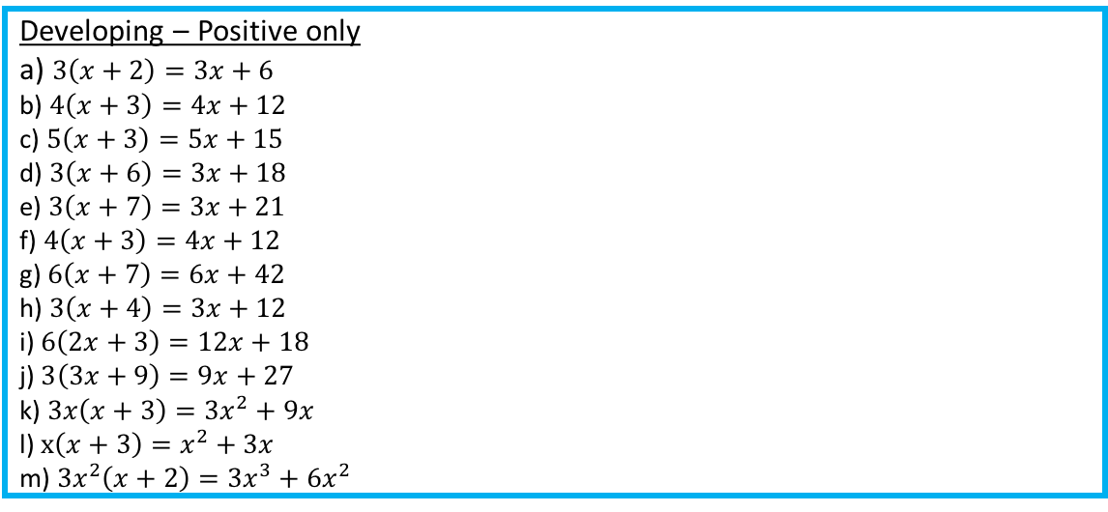
Developing – Positive only
a) $3\left(x+2\right)=3x+6$
b) $4\left(x+3\right)=4x+12$
c) $5\left(x+3\right)=5x+15$
d) $3\left(x+6\right)=3x+18$
e) $3\left(x+7\right)=3x+21$
f) $4\left(x+3\right)=4x+12$
g) $6\left(x+7\right)=6x+42$
h) $3\left(x+4\right)=3x+12$
i) $6\left(2x+3\right)=12x+18$
j) $3\left(3x+9\right)=9x+27$
k) $3x\left(x+3\right)=3x^{2}+9x$
l) $x\left(x+3\right)=x^{2}+3x$
m) $3x^{2}\left(x+2\right)={3x}^{3}+6x^{2}$
Securing - Negative
a) $4\left(x−2\right)=4x−8$
b) $7\left(x−3\right)=7x−21$
c) $5\left(x−3\right)=5x−15$
d) $4\left(x−5\right)=4x−20$
e) $5\left(x−5\right)=5x−25$
f) $7\left(x−7\right)=7x−49$
g) $6\left(x−6\right)=6x−36$
h) $4\left(2x−2\right)=8x−8$
i) $x\left(x−9\right)=x^{2}−9x$
j) $7x\left(x−3\right)=7x^{2}−21x$
k) $8x\left(2x−6\right)=16x^{2}−48x$
Mastering – Find the area
$$5x+25$$
$$4x+12$$
$$3x−12$$
$$5x−40$$

