Slide 1
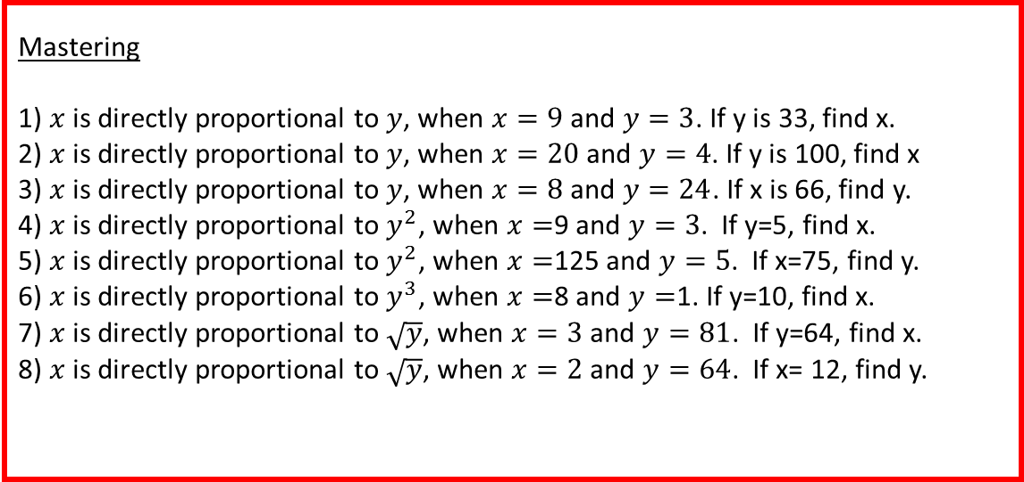
Developing – Which of these is the best deal?
Two loaves for £2 or 3 for £3.10
10 packets of sweets for £2 or 15 packets for £3.00
3 packets of crisps for 90p or 5 packets for £1.80
2 books for £6 or 3 books for £8
6 biscuits for £2 or 10 biscuits for £3
A cup of tea for 60p or 3 cups for £1.50
8 toilet rolls for £4 or 12 for £5
10 chairs for £65 or 12 chairs for £72
Developing – Are these in proportion?
The amount of rain and the height of the river
The temperature and sales of ice cream
The height and weight of someone
The temperate and what happens in the day
Price of oil and the amount of oil bought
The amount of ingredients in a recipe and the amount of people eating
Your exam mark in Maths and your exam mark in English
Securing – Write an equation linking $x$ and $y$
1) $x$ is directly proportional to $y$, when $x=9$ and $y=3$.
2) $x$ is directly proportional to $y$, when $x=20$ and $y=4$.
3) $x$ is directly proportional to $y$, when $x=8$ and $y=24$.
4) $x$ is directly proportional to $y^{2}$, when $x=$9 and $y=3$.
5) $x$ is directly proportional to $y^{2}$, when $x=$125 and $y=5$.
6) $x$ is directly proportional to $y^{3}$, when $x=$8 and $y=$1.
7) $x$ is directly proportional to $\sqrt{y}$, when $x=3$ and $y=81$.
8) $x$ is directly proportional to $\sqrt{y}$, when $x=2$ and $y=64$.
Mastering
1) $x$ is directly proportional to $y$, when $x=9$ and $y=3$. If y is 33, find x.
2) $x$ is directly proportional to $y$, when $x=20$ and $y=4$. If y is 100, find x
3) $x$ is directly proportional to $y$, when $x=8$ and $y=24$. If x is 66, find y.
4) $x$ is directly proportional to $y^{2}$, when $x=$9 and $y=3$. If y=5, find x.
5) $x$ is directly proportional to $y^{2}$, when $x=$125 and $y=5$. If x=75, find y.
6) $x$ is directly proportional to $y^{3}$, when $x=$8 and $y=$1. If y=10, find x.
7) $x$ is directly proportional to $\sqrt{y}$, when $x=3$ and $y=81$. If y=64, find x.
8) $x$ is directly proportional to $\sqrt{y}$, when $x=2$ and $y=64$. If x= 12, find y.

Slide 2
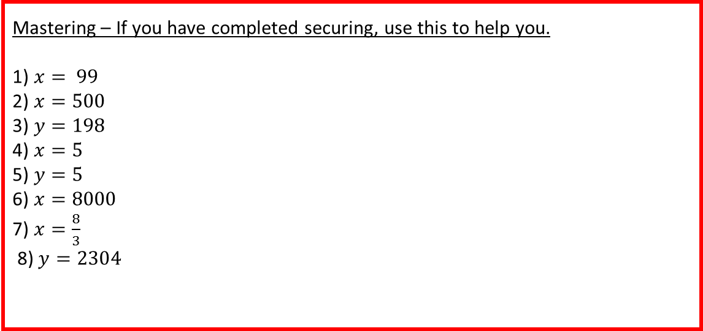
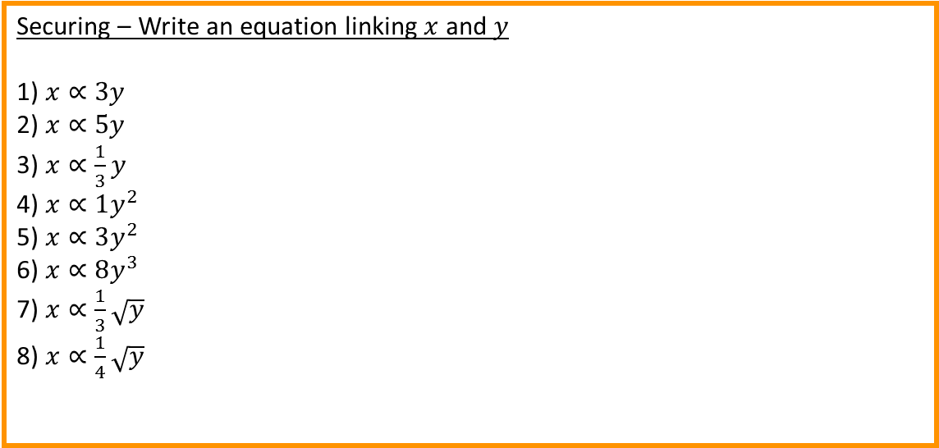
Developing – Which of these is the best deal?
Two loaves for £2
Both
3 packets of crisps for 90p
3 books for £8
10 biscuits for £3
3 cups for £1.50
12 for £5
12 chairs for £72
Developing – Are these in proportion?
Yes
Yes
No
No
Yes
Yes
No
Securing – Write an equation linking $x$ and $y$
1) $x∝3y$
2) $x∝5y$
3) $x∝\frac{1}{3}y$
4) $x∝1y^{2}$
5) $x∝3y^{2}$
6) $x∝8y^{3}$
7) $x∝\frac{1}{3}\sqrt{y}$
8) $x∝\frac{1}{4}\sqrt{y}$
Mastering – If you have completed securing, use this to help you.
1) $x= 99$
2) $x=500$
3) $y=198$
4) $x=5$
5) $y=5$
6) $x=8000$
7) $x=\frac{8}{3}$
8) $y=2304$

