Slide 1
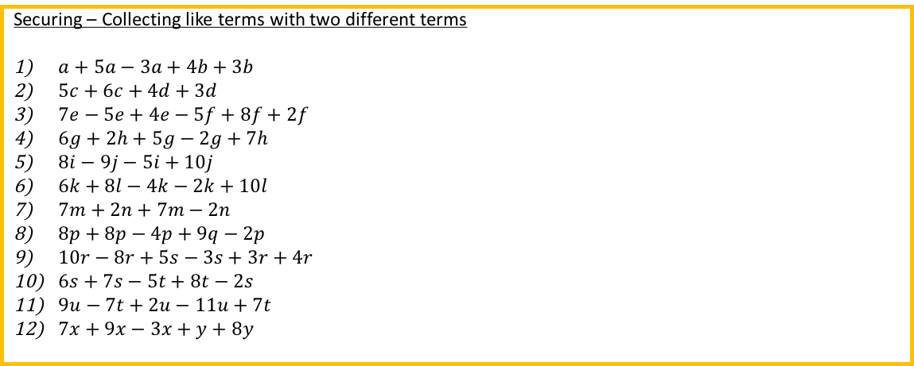
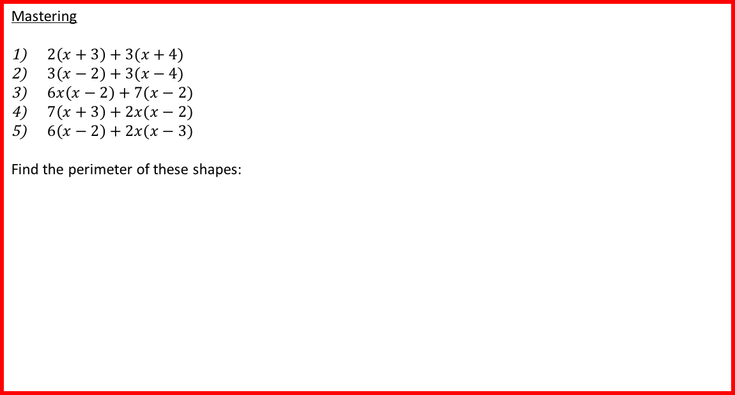
Developing – Collecting like terms
$a+2a+3a$
$3b+4b+5b−3b$
$4c+7c−5c+2c$
$6d−4d+3d+6d$
$6e+6e−7e−2e$
$f+f+8f−9f$
$9g−5g+2g+7g$
$7h+8h−3h−5h$
$9i+10i−7i$
$8j+10j−8j−9j$
$7k+7k−14k$
$11l+5l−6l−6l$
$9m−8m+10m+5m$
$8n−7n+7n+10n$
Securing – Collecting like terms with two different terms
$a+5a−3a+4b+3b$
$5c+6c+4d+3d$
$7e−5e+4e−5f+8f+2f$
$6g+2h+5g−2g+7h$
$8i−9j−5i+10j$
$6k+8l−4k−2k+10l$
$7m+2n+7m−2n$
$8p+8p−4p+9q−2p$
$10r−8r+5s−3s+3r+4r$
$6s+7s−5t+8t−2s$
$9u−7t+2u−11u+7t$
$7x+9x−3x+y+8y$
Mastering
$2\left(x+3\right)+3(x+4)$
$3\left(x−2\right)+3(x−4)$
$6x\left(x−2\right)+7(x−2)$
$7\left(x+3\right)+2x(x−2)$
$6\left(x−2\right)+2x(x−3)$
Find the perimeter of these shapes:
$$x+2$$
$$7$$
$$7$$
7$x$
7$x$
$$x+2$$
2$x+2$
$$x−6$$

Slide 2
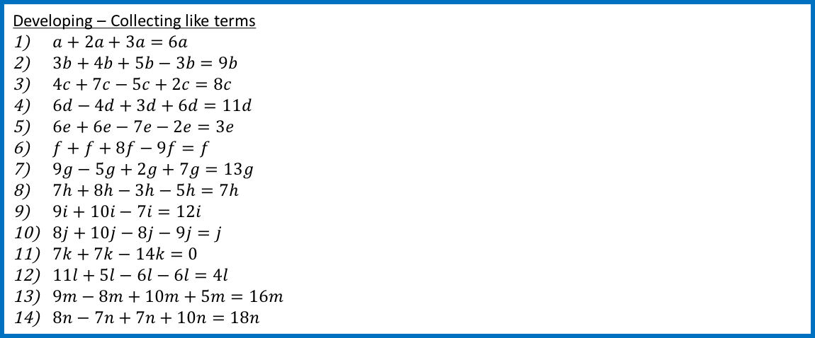
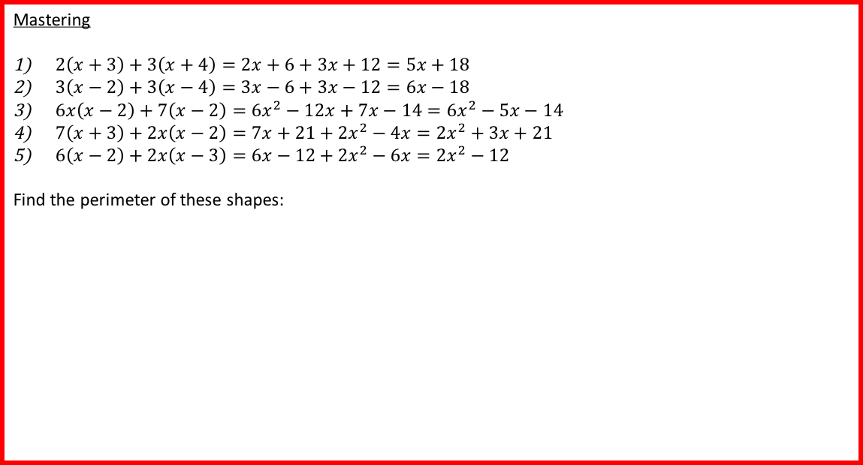
Developing – Collecting like terms
$a+2a+3a=6a$
$3b+4b+5b−3b=9b$
$4c+7c−5c+2c=8c$
$6d−4d+3d+6d=11d$
$6e+6e−7e−2e=3e$
$f+f+8f−9f=f$
$9g−5g+2g+7g=13g$
$7h+8h−3h−5h=7h$
$9i+10i−7i=12i$
$8j+10j−8j−9j=j$
$7k+7k−14k=0$
$11l+5l−6l−6l=4l$
$9m−8m+10m+5m=16m$
$8n−7n+7n+10n=18n$
Securing – Collecting like terms with two different terms
$a+5a−3a+4b+3b=3a+7b$
$5c+6c+4d+3d=11c+7d$
$7e−5e+4e−5f+8f+2f=6e+5f$
$6g+2h+5g−2g+7h=9g+9h$
$8i−9j−5i+10j=3i+j$
$6k+8l−4k−2k+10l=18l$
$7m+2n+7m−2n=14m$
$8p+8p−4p+9q−2p=10p+9q$
$10r−8r+5s−3s+3r+4r=9r+2s$
$6s+7s−5t+8t−2s=11s+3t$
$9u−7t+2u−11u+7t=0$
$7x+9x−3x+y+8y=13x+9y$
Mastering
$2\left(x+3\right)+3\left(x+4\right)=2x+6+3x+12=5x+18$
$3\left(x−2\right)+3\left(x−4\right)=3x−6+3x−12=6x−18$
$6x\left(x−2\right)+7\left(x−2\right)={6x}^{2}−12x+7x−14=6x^{2}−5x−14$
$7\left(x+3\right)+2x\left(x−2\right)=7x+21+2x^{2}−4x=2x^{2}+3x+21$
$6\left(x−2\right)+2x\left(x−3\right)=6x−12+2x^{2}−6x=2x^{2}−12$
Find the perimeter of these shapes:
$$x+2$$
$$7$$
$$7$$
7$x$
7$x$
$$x+2$$
2$x+2$
$$x−6$$
$$2x+18$$
$$16x+2$$
$$5x−30$$

