Slide 1
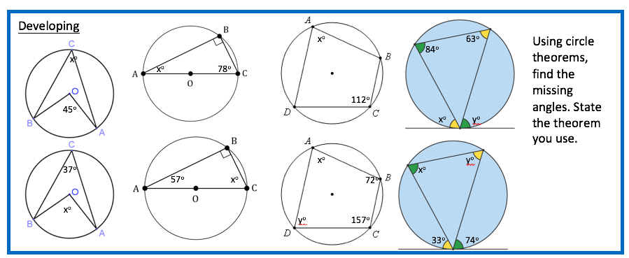
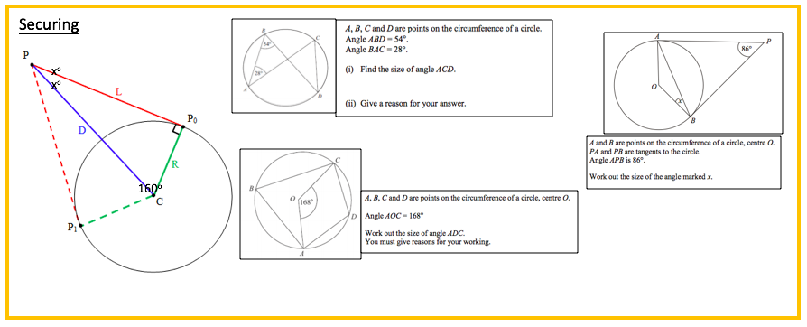
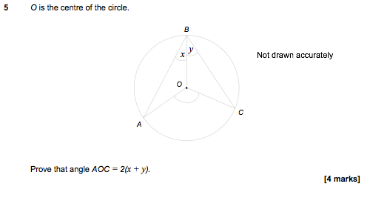
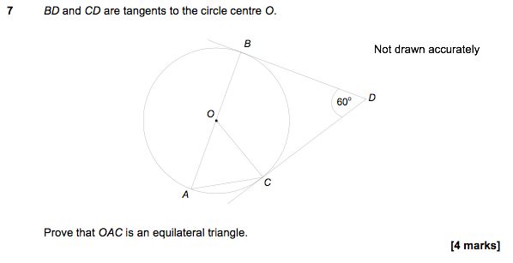
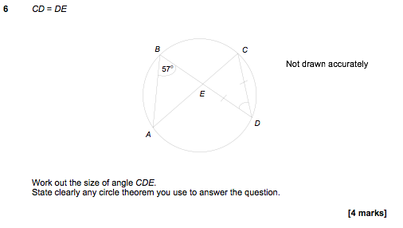
Mastering

Slide 2
Developing
Angles at the centre are double those at the edge – 22.5º
Angles in a triangle add up to 180º, angle at the edge = 90º. 12º
Opposite angles in a cyclic quadrilateral add to 180º, 68º
Alternate segment theory – x=63º, y=84º
Angles at the centre are double those at the edge – 74º
Angles in a triangle add up to 180º, angle at the edge = 90º. 33º
Opposite angles in a cyclic quadrilateral add to 180º, y=108º, x=23º
Alternate segment theory – x=74º, y=33º
Securing
Tangents create a 90º angle, so other two angles must add to 180º. 160+2x=180, x=10º
Angle ACD is 54º, angles in the same segment are equal
ABC=84(angle at the centre is double), ADC=96(Opposite angles in a cyclic add to make 180º)
OBC=90º, OAB=90º, AOB=94º, Isosceles triangle so 180-94=86/2 x=4
Mastering

