Slide 1
Developing – Multiplying Fractions
1) $\frac{1}{3}×\frac{2}{4}$ 5) $\frac{3}{7}×\frac{3}{8}$
2) $\frac{1}{2}×\frac{2}{3}$ 6) $\frac{4}{9}×\frac{3}{12}$
3) $\frac{5}{7}×\frac{2}{3}$ 7) $\frac{3}{7}×\frac{8}{1}$
4) $\frac{12}{15}×\frac{1}{4}$ 8) $\frac{10}{7}×\frac{8}{3}$
Developing – Dividing Fractions
1) $\frac{1}{3}÷\frac{2}{4}$ 5) $\frac{3}{7}÷\frac{3}{8}$
2) $\frac{1}{2}÷\frac{2}{3}$ 6) $\frac{4}{9}÷\frac{3}{12}$
3) $\frac{5}{7}÷\frac{2}{3}$ 7) $\frac{3}{7}÷\frac{8}{1}$
4) $\frac{12}{15}÷\frac{1}{4}$ 8) $\frac{10}{7}÷\frac{8}{3}$
Securing – Adding Fractions
1) $\frac{1}{2}+\frac{2}{4}$ 5) $\frac{3}{7}+\frac{3}{8}$
2) $\frac{1}{2}+\frac{2}{6}$ 6) $\frac{4}{9}+\frac{3}{12}$
3) $\frac{5}{7}+\frac{2}{3}$ 7) $\frac{3}{7}+\frac{8}{1}$
4) $\frac{12}{15}+\frac{1}{4}$ 8) $\frac{10}{7}+\frac{8}{3}$
Securing – Subtracting Fractions
1) $\frac{1}{2}−\frac{2}{4}$ 5) $\frac{3}{7}−\frac{3}{8}$
2) $\frac{1}{2}−\frac{2}{6}$ 6) $\frac{4}{9}−\frac{3}{12}$
3) $\frac{5}{7}−\frac{2}{3}$ 7) $\frac{3}{7}−\frac{1}{8}$
4) $\frac{12}{15}−\frac{1}{4}$ 8) $\frac{10}{7}−\frac{8}{3}$
Mastering – Fill in the missing spaces
1) $\frac{1}{3}×\frac{2}{}=\frac{}{21}$ 5) $\frac{3}{7}÷\frac{}{8}=\frac{24}{14}$
2) $\frac{}{7}×\frac{3}{6}=\frac{24}{}$ 6) $\frac{}{9}÷\frac{3}{}=\frac{13}{27}$
3) $\frac{5}{}×\frac{}{3}=\frac{15}{45}$ 7) $\frac{5}{6}÷\frac{}{}=\frac{35}{24}$
4) $\frac{}{}×\frac{1}{4}=\frac{34}{28}$ 8) $\frac{6}{7}÷\frac{}{5}=\frac{}{42}$
Mastering – Fill in the missing spaces
1) $\frac{4}{7}+\frac{}{7}=\frac{6}{7}$ 5) $\frac{3}{7}−\frac{1}{}=\frac{16}{56}$
2) $\frac{1}{2}+\frac{}{6}=\frac{5}{6}$ 6) $\frac{7}{11}−\frac{3}{}=\frac{}{99}$
3) $\frac{5}{7}+\frac{}{4}=\frac{34}{28}$ 7) $\frac{5}{}−\frac{}{8}=\frac{13}{72}$
4) $\frac{}{12}+\frac{1}{9}=\frac{13}{36}$ 8) $\frac{3}{5}−\frac{}{}=\frac{8}{10}$

Slide 2
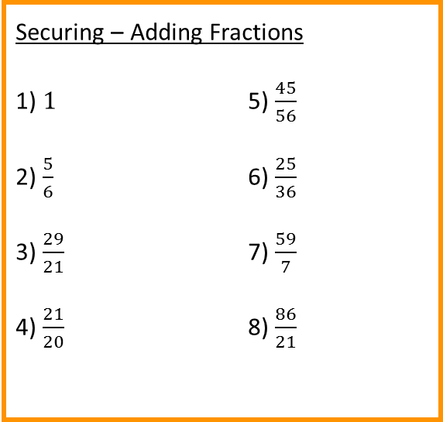
Developing – Multiplying Fractions
1) $\frac{1}{6}$ 5) $\frac{9}{56}$
2) $\frac{1}{3}$ 6) $\frac{1}{9}$
3) $\frac{10}{21}$ 7) $\frac{24}{7}$
4) $\frac{12}{60}=\frac{1}{4}$ 8) $\frac{80}{21}$
Developing – Dividing Fractions
1) $\frac{2}{3}$ 5) $\frac{8}{7}$
2) $\frac{3}{4}$ 6) $\frac{16}{9}$
3) $\frac{15}{14}$ 7) $\frac{3}{56}$
4) $\frac{16}{5}$ 8) $\frac{15}{28}$
Securing – Adding Fractions
1) $1$ 5) $\frac{45}{56}$
2) $\frac{5}{6}$ 6) $\frac{25}{36}$
3) $\frac{29}{21}$ 7) $\frac{59}{7}$
4) $\frac{21}{20}$ 8) $\frac{86}{21}$
Securing – Subtracting Fractions
1) $0$ 5) $\frac{3}{56}$
2) $\frac{1}{6}$ 6) $\frac{7}{36}$
3) $\frac{1}{21}$ 7) $\frac{17}{56}$
4) $\frac{11}{20}$ 8) $−\frac{26}{21}$
Mastering – Fill in the missing spaces
1) $\frac{1}{3}×\frac{2}{7}=\frac{2}{21}$ 5) $\frac{3}{7}÷\frac{2}{8}=\frac{24}{14}$
2) $\frac{8}{7}×\frac{3}{6}=\frac{24}{42}$ 6) $\frac{1}{9}÷\frac{3}{13}=\frac{13}{27}$
3) $\frac{5}{15}×\frac{3}{3}=\frac{15}{45}$ 7) $\frac{5}{6}÷\frac{4}{7}=\frac{35}{24}$
4) $\frac{34}{7}×\frac{1}{4}=\frac{34}{28}$ 8) $\frac{6}{7}÷\frac{6}{5}=\frac{30}{42}$
Mastering – Fill in the missing spaces
1) $\frac{4}{7}+\frac{2}{7}=\frac{6}{7}$ 5) $\frac{3}{7}−\frac{1}{7}=\frac{16}{56}$
2) $\frac{1}{2}+\frac{2}{6}=\frac{5}{6}$ 6) $\frac{7}{11}−\frac{3}{9}=\frac{36}{99}$
3) $\frac{5}{7}+\frac{2}{4}=\frac{34}{28}$ 7) $\frac{5}{9}−\frac{3}{8}=\frac{13}{72}$
4) $\frac{3}{12}+\frac{1}{9}=\frac{13}{36}$ 8) $\frac{3}{5}−−\frac{1}{5}=\frac{8}{10}$

